Slide 1
MGM Workshop - Introduction Nikos Kyrpides Head of Prokaryotic Super Program
September 26, 2016

Slide 2
MGM Workshop - JGI Overview Axel Visel Acting Director, JGI
September 26, 2016

Slide 3

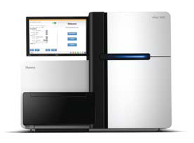
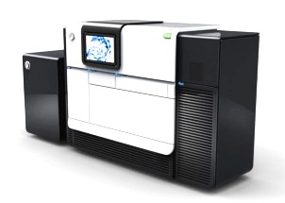
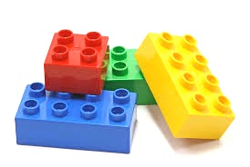
Outline
What is a User Facility?
Capabilities
User Opportunities

Slide 4
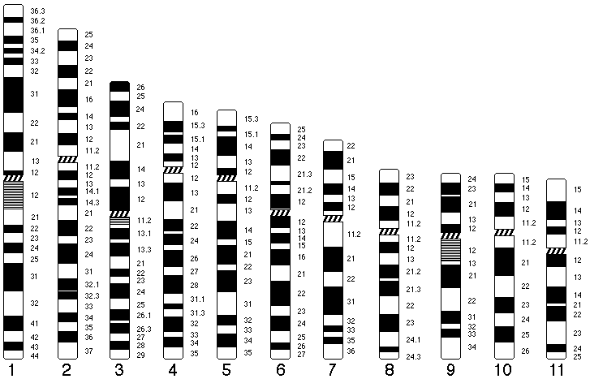
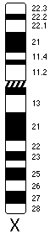
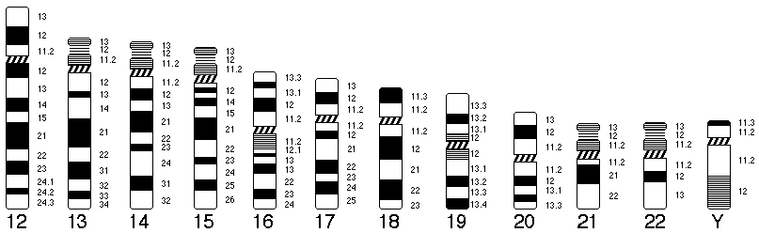

Early Days: The Human Genome Project
1997-2004
Sanger CTR
Wash U
Baylor
Broad (MIT)
Biomed +
Biomed +
Biomed +
Biomed +
DOE Mission Science
(operates as user facility)
G5
DOE JGI

Slide 5

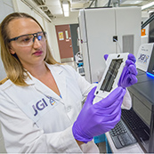

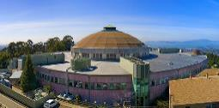
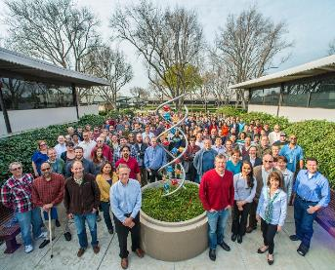
DOE Joint Genome Institute
A U.S. Department of Energy Office of Science User Facility
DOE User Facilities enable large-scale science
Funded by DOE Office of Science
Walnut Creek, CA
facility opened in 1998
~270 staff

Slide 6
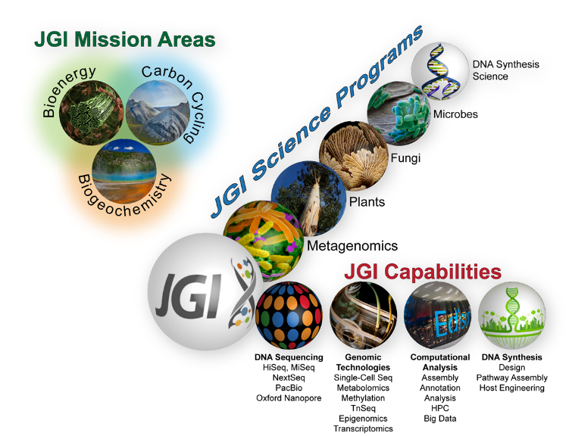
JGI: A Genomics User Facility
OUR MISSION:
To advance energy and environmental science by providing access to state-of-the-art genomics capabilities

Slide 7

Strategic Directions
VISION:
Evolve from a production sequencing center to a Next-Generation Genome Science User Facility
Conversion of Genomic Data to Biological Insights
High throughput approaches for converting sequence data into functional information
JGI Strategic Plan
Available at jgi.doe.gov

Slide 8
Outline
What is a User Facility?
Capabilities
User Opportunities

Slide 9


Capabilities
Sequencing Technologies

Slide 10

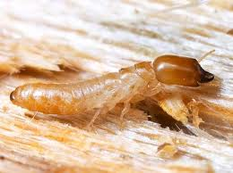
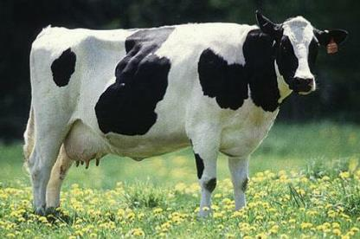

The JGI sequences 100’s of isolates from wide variety of environments

Slide 11
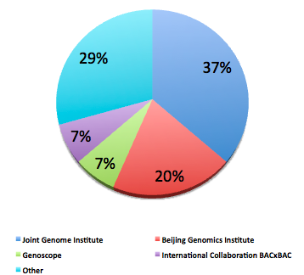
Leadership in Plant & Microbial Genomes
Plant Genomes
JGI
JGI
JGI
JGI
Notes:
Slide Updated
*

Slide 12
Yearly Sequencing Output (Tb)

Slide 13
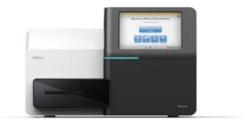
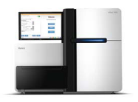
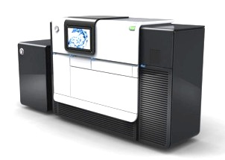

Current Platforms
 | MISEQ | HISEQ | PACBIO
# at JGI | 5 | 8 | 5
OUTPUT | ★★ | ★★★★★ | ★
SPEED | ★★★ | ★ | ★★★★★
COST | ★★ | ★★★★★ | ★
READ-LENGTH | ★★ | ★★ | ★★★★★
ACCURACY | ★★★★ | ★★★★ | ★
Chris Daum
Notes:
LEN: Updated slide?

Slide 14
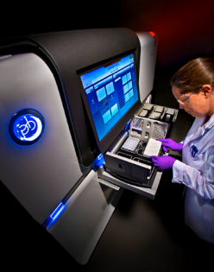
PacBio Sequencing Platform
Major Improvements in Read Length (current average: 12kb…)

Slide 15
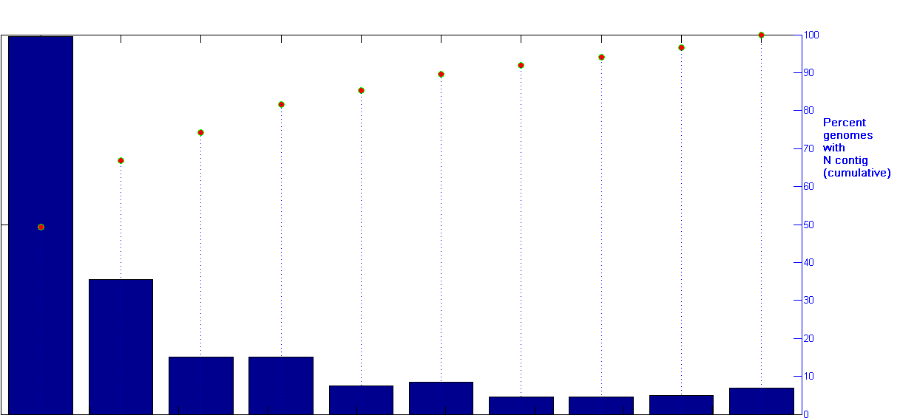
Return of the Finished Microbial Genome? The Power of PacBio Single Molecule Data
200
100
Number of Genomes
% Genomes
100
50
0
0
1
2
3
4
5
6
7
8
9
10
Number of Contigs

Slide 16
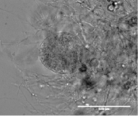
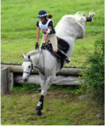
PacBio Read-length Improvements
PacBio vs Illumina Fungal Genomes
Piromyces sp. Finn genome
51% repeats, 21% G+C
232 contigs in 56.5 Mb PacBio assembly
8191 contigs in 40.1 Mb Illumina assembly
Lignocellulose-degrading fungus from horse gut
Largest PacBio contig (2.5Mb)
Illumina contigs aligned to PacBio contig
Sequences missing from Illumina assembly
Current cost for standard fungal draft genomes:
Illumina Only $1400
PacBio Only $1400-2800

Slide 17
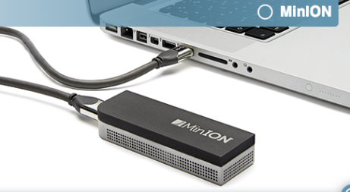
Nascent Technology: Oxford Nanopore

Slide 18
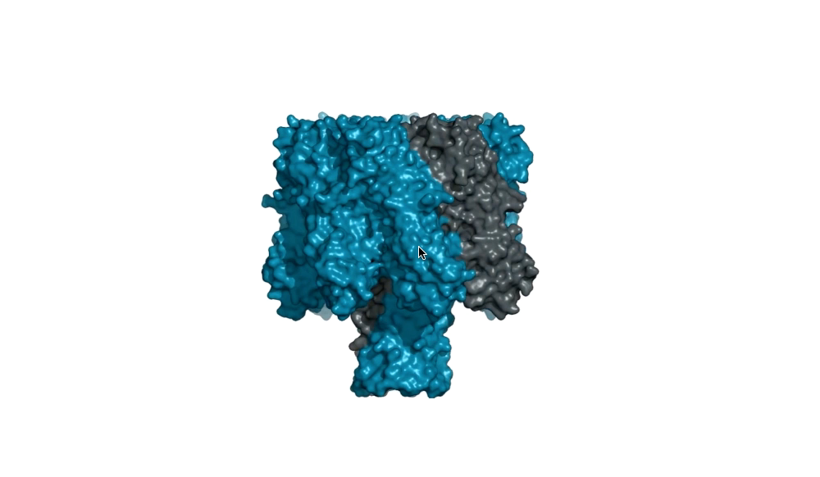
Nanopore Sequencing
Notes:
In its devices, Oxford Nanopore passes an ionic current through nanopores and measures the changes in current as biological molecules pass through the nanopore or near it. The information about the change in current can be used to identify that molecule.

Slide 19
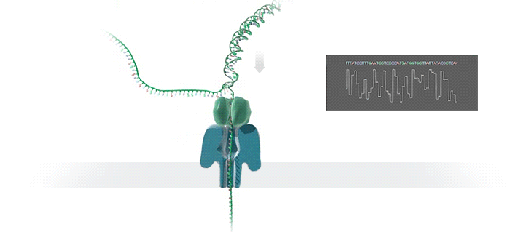
ONT Sequencing
No polymerase or amplification needed → as long as DNA intact, long reads possible
Source: Oxford Nanopore Technologies

Slide 20
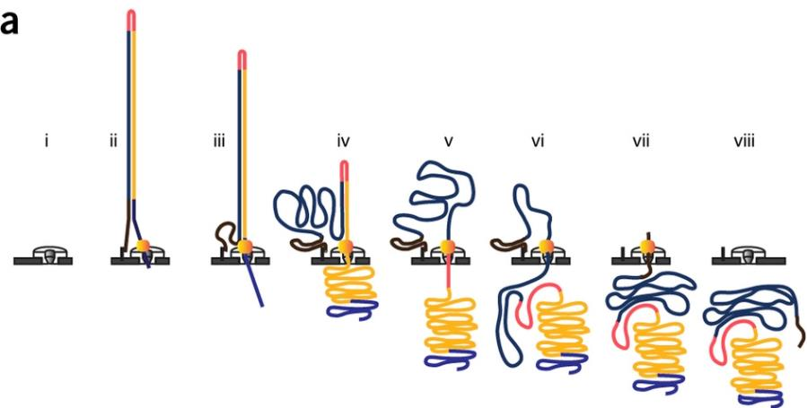
Nanopore Sequencing
hairpin
motor
protein
tether
nanopore
leader
sequence

Slide 21
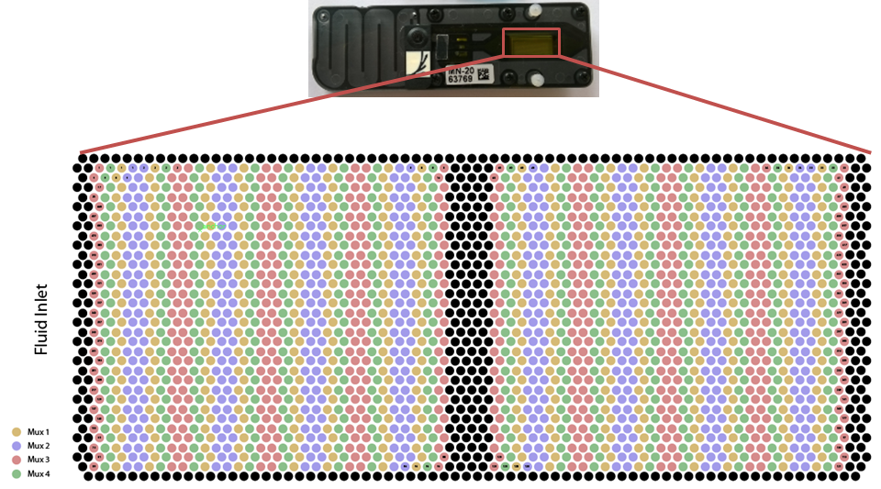
Flow Cell Layout
512 sequencing channels → each channel sequences multiple molecules

Slide 22
Capabilities
Sequencing Technologies
Diversity Surveys

Slide 23
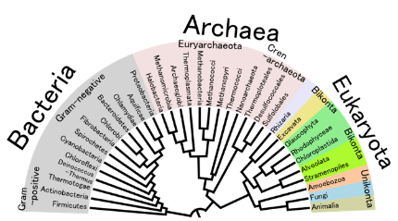
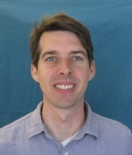
Diversity Surveys (iTags)
Prokaryotes
Eukaryotes
16S
23S
5S
18S
ITS1
5.8S
ITS2
28S
16S v4
Prokaryote Specific
18S:
Eukaryote
Specific
ITS2:
Fungal
specific
Adam Rivers

Slide 24
Capabilities
Sequencing Technologies
Diversity Surveys
Single-Cell

Slide 25

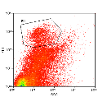
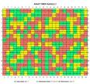
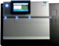
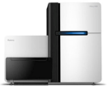
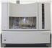
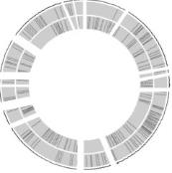

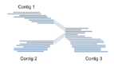
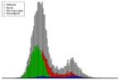
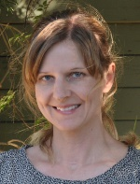
Yet we also can capture unculturables
Single Cell Genomics Pipeline
Sampling
Cell sorting
Genome amplification
Cell identification
Sequencing
Tanja Woyke
Annotation
Assembly
Data QC
Draft Genome

Slide 26
Capabilities
Sequencing Technologies
DNA Synthesis
Diversity Surveys
Single-Cell

Slide 27
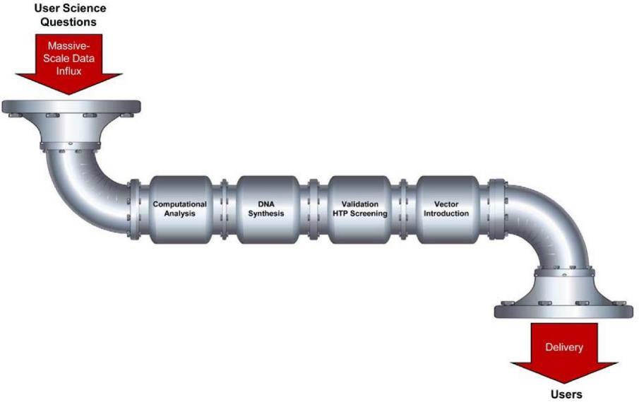
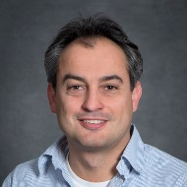
JGI Integrated Synthesis Pipeline
From Reading to Writing: DNA Synthesis
Sam Deutsch

Slide 28
Capabilities
Sequencing Technologies
DNA Synthesis
Diversity Surveys
Metabolomics
Single-Cell

Slide 29
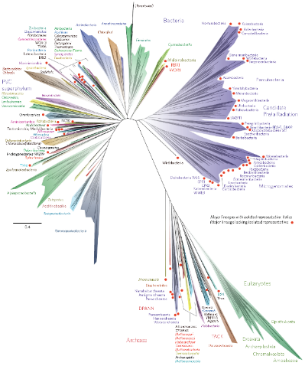
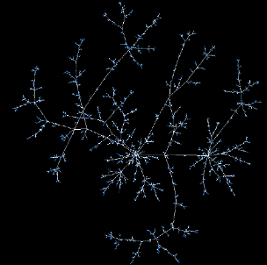

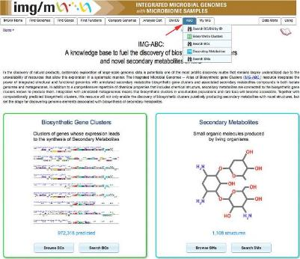

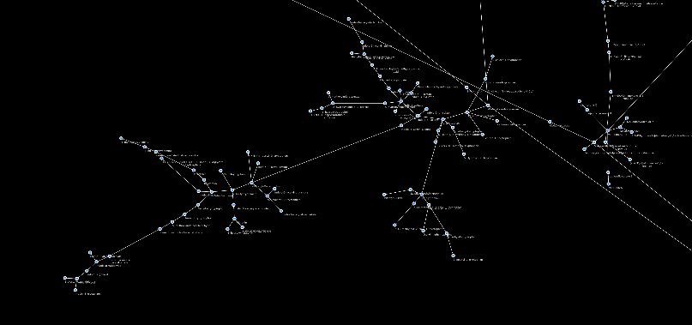


Metabolomics
Genomic Universe
Biochemical Universe
DNA Synthesis
Leslie Silva
Predicted Genes
Predicted Metabolites
Integrate Metabolomics and Genomics
Notes:
By offering metabolomics, sequencing and synthesis JGI users can access the genomic universe and the biochemical universe.
17 CSP LOI including metabolomics!
The dark graphs show all metabolites in our IMG + MetaboliteAtlas (Some 15,000 metabolites now working on 10x network with NERSC) linked by chemical rules.
Synergy: Integration of gene with metabolite predictions strengthens both
That is if you predict a metabolite based on the sequence and it matches the metabolite you predict based on metabolomics you have much higher confidence in both.
The same would be true for classes of metabolites which you might also predict based on both sequence and metabolomics.

Slide 30


Capabilities
Sequencing Technologies
DNA Synthesis
Diversity Surveys
Metabolomics
Single-Cell
ComputationalTechnologies

Slide 31

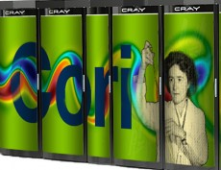
Computational Technologies
PIPELINES
iTag pipeline (JGI data)
Microbial genome & Metagenome assembly (JGI & external data)
Microbial Genome annotation pipeline (JGI & external data)
Metagenome annotation pipeline (JGI & external data)
Transcriptomics/Metatranscriptomics pipelines (JGI & external data)
Methylation annotation pipeline (JGI data)
Binning & visualization (eg MetaBat, Elviz)
Single Cell decontamination (eg ProDeGe)
Gene Calling QC (eg GenePrimp)
Metadata management system (GOLD)
Comparative analysis data management system (IMG)
Fungal (MycoCosm) and Plant (Phytozome)
TOOLS
DATABASES

Slide 32
Outline
What is a User Facility?
Capabilities
User Opportunities

Slide 33
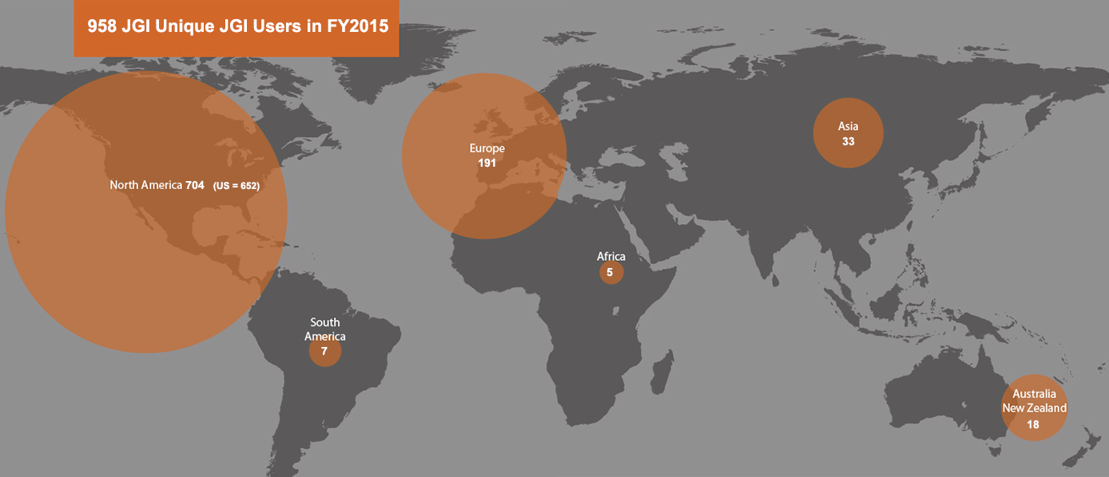
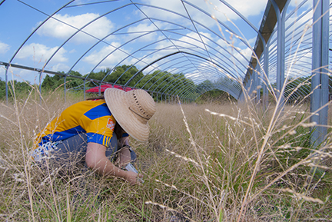
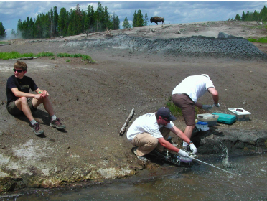

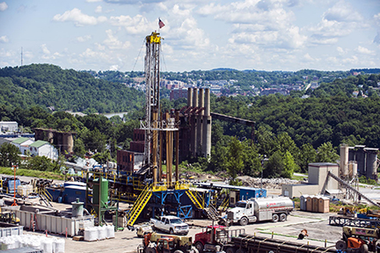
JGI Worldwide User Community
514 projects active in FY2016
65 projects completed
160 new projects initiated
33

Slide 34

Community Science Program
Annual call
Announced in January
Letters of intent due in early April
Proposals due early June
Review in July
Start in October
Review criteria
Scientific Merit
DOE relevance
Other calls
JGI-EMSL Call (FICUS)
DNA Synthesis Call
Small-scale metagenomics & single cell Call
jgi.doe.gov

Slide 35


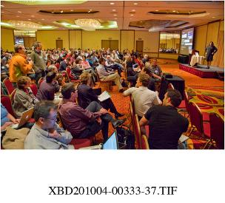
JGI Annual Meeting
450+ attendees
Plant/Fungal/Microbial Genomics
DNA Synthesis & Synthetic Biology
Single-Cell Genomics, Functional Genomics
HPC for Next-Gen Sequencing Applications
Etc. etc. etc.
Invited presentations, workshops and tutorials on sequence-based bioinformatics, and data management systems.
March 21-23, 2017
Walnut Creek, California

Slide 36
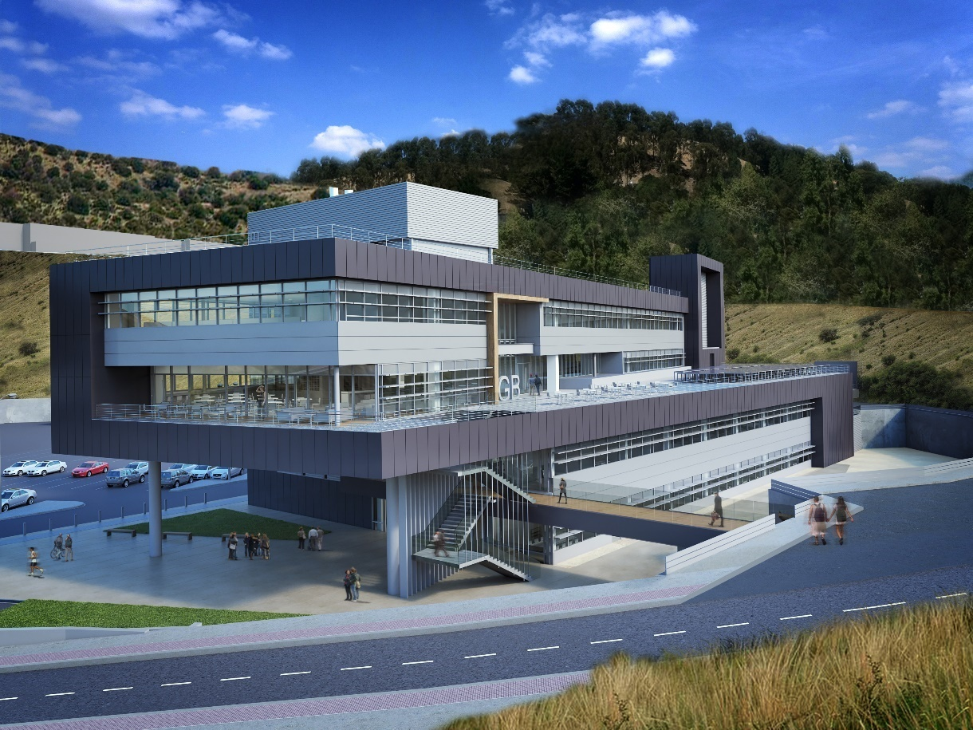
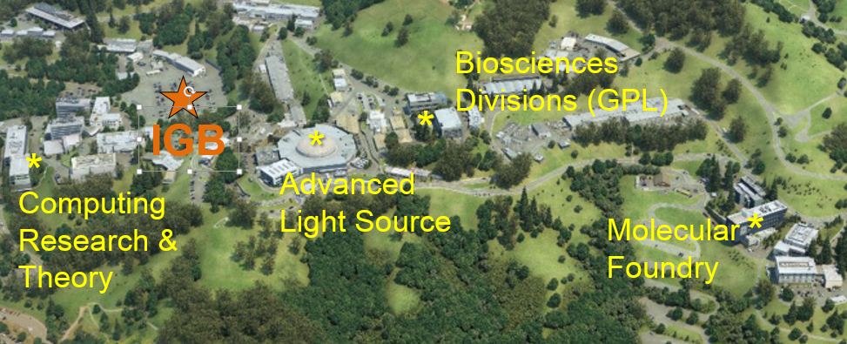
JGI Moves!
Synergies from Proximity to LBL User Facilities and Science Programs
IGB Building on LBL Bioscience Campus (2019)

Slide 37
Thank you for your attention!
Axel Visel
avisel@lbl.gov
jgi.doe.gov

